Slide 1
Confidentiality
By reviewing this presentation or participating in a SRC event, you are agreeing not to use the presented information for purposes unrelated to the event until approved by SRC;
Material may be presented that represents current research, some of which has not been published or protected. This material is not for public disclosure and until potential IP rights have been protected, please treat all of the information presented as confidential information which is the property of the researcher and their university.

Slide 2
Novel Super-Resolution and MIMO Techniques for Automotive and Emerging Radar Applications
Murat Torlak, UT Dallas
SRC Task 2712.029

Slide 3
Novel Super-Resolution and MIMO Techniques for Automotive and Emerging Radar Applications 2712.029, Murat Torlak, University of Texas at Dallas
Technical Thrust: Analog/Mixed-Signal Circuits, Systems, and Devices (AMS-CSD)
Task Leader: Murat Torlak, Professor, University of Texas at Dallas
Industrial Liaisons: Dan Wang (Texas Instruments)
Anticipated Results: Algorithms which utilize the hardware efficiently and produce robust estimation of high resolution radar images in complex environments.
Task Description: Develop novel super-resolution and MIMO techniques to achieve high-performance and low complexity for automotive and emerging radar applications.
Task Deliverables: (1) Development of mathematical models of the proposed robust and low complexity high resolution imaging techniques and their software implementation (2) MIMO mathematical models and software implementation
Start Date: Aug. 2017

Slide 4
Students on Task 2712.029
Graduated Students and Current Affiliation
Dr. Muhammet Emin Yanik, May 2020
Current Students and Anticipated Graduation Date
Ashwin Bhobani Baral, Aug 2021
Bhaskar Raj Upadhyay, Aug 2022
Josiah Wayland Smith, Aug 2022
Internships and Full-Time Offers
Muhammet Emin Yanik, TI, Full-time (Jan’20)
Josiah Wayland Smith, Imec, Internship, Sum’20

Slide 5
Executive Summary
Accomplishments during the past year
Completed 2D mmWave Fast SAR imager
Developed 3D MIMO-ISAR imaging testbed/algorithms
Developed vital sign monitoring algorithms
Future direction – highlighting changes
Development of real-time MIMO algorithms for increasing detection and tracking accuracy in dynamic time-variant and multipath environments
Demonstration of mm-Wave radar technology in-home monitoring/fall detection and for video game players

Slide 6
Motivation and Agenda
mmWave imaging technology is one of the fastest growing technologies of this decade with wide range of applications.
Security screening, Vital sign monitoring, Gesture recognition,
Automotive radars, Smart homes, UAV radars and imaging
Application I: mmWave MIMO-ISAR Imaging prototype
System model and algorithms
Based on TI 77 GHz mmWave radar sensors
Mechanical scanner
Experimental Results
Application II: Vital Sign Detection
Algorithms verified via pendulum/speakers
Pilot experiments
Publications/Ongoing Work and Future Directions

Slide 7
Application I: Efficient SAR Imaging for Non-Cooperative Scanning Geometries
Josiah Smith

Slide 8
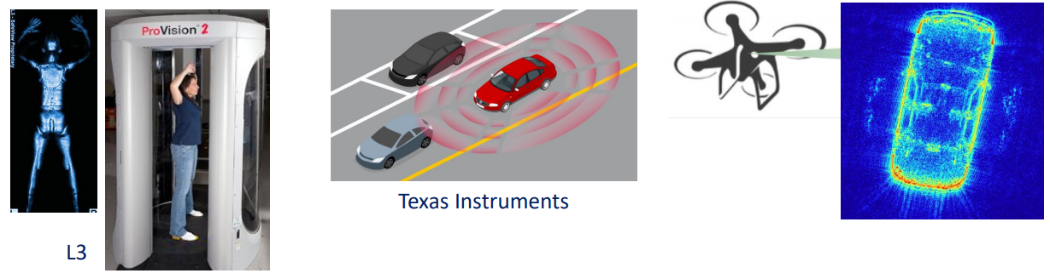
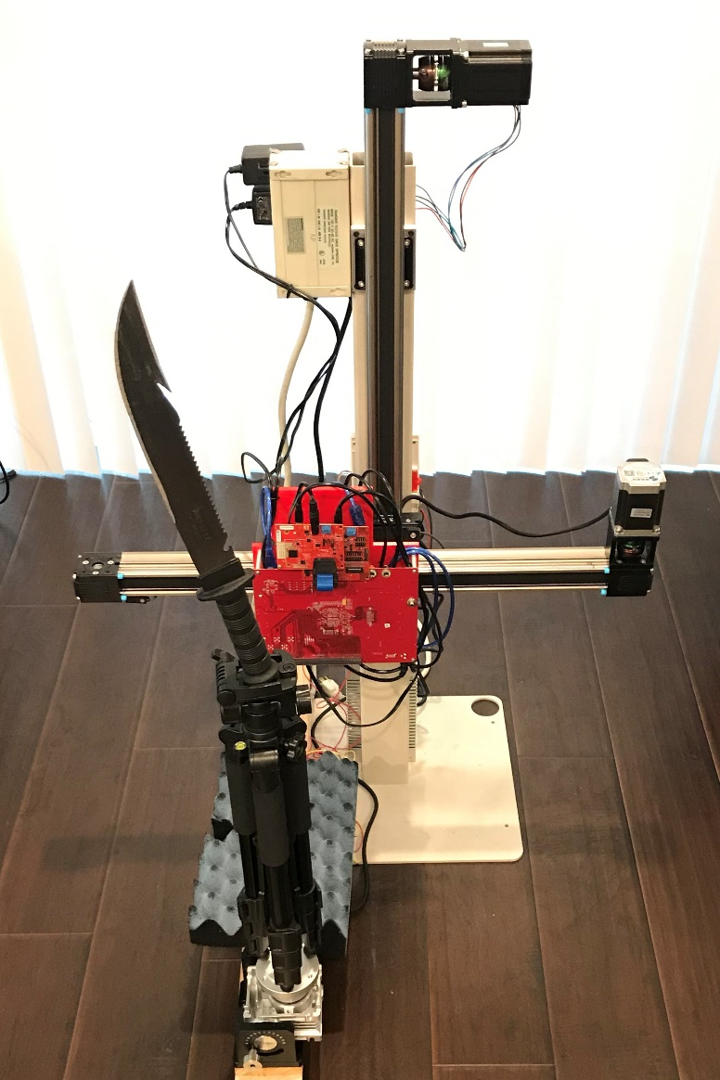
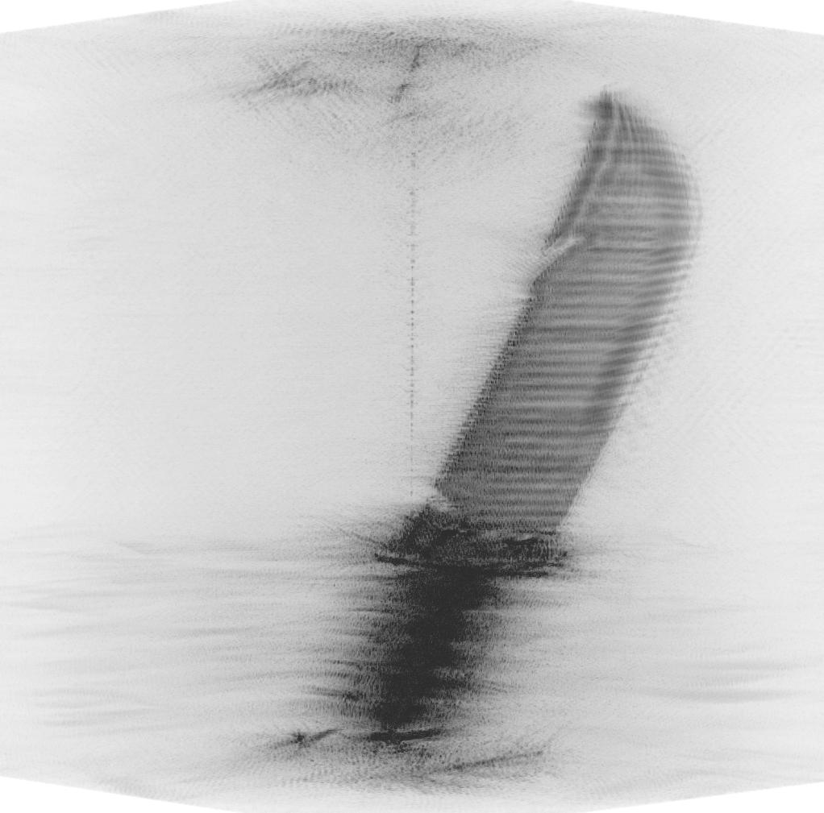
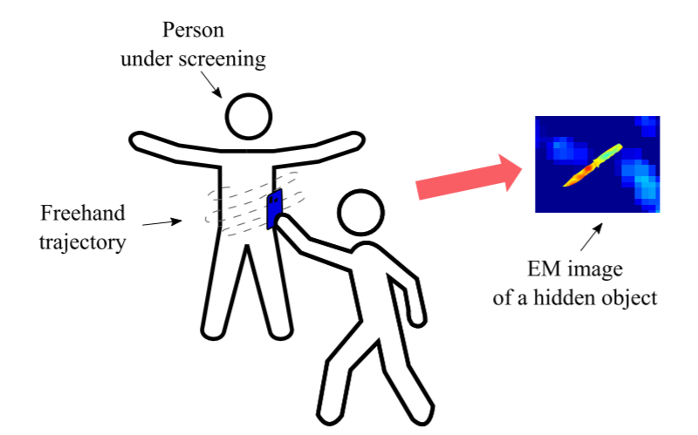



Motivation – Non-Cooperative Array Imaging
Traditional array imaging techniques require highly controlled positioning for SAR scanning apparatus
Emerging applications require relaxing this constraint
Smart phone mmWave scanner: mobile threat detection
ISSUE: limited computation power on cell phone
Automotive SAR imaging
Challenge:
Efficient image reconstruction algorithms rely on simple scanning patterns
Non-cooperative scanning patterns are typically considered infeasible due to computational expense
Traditional Array Imaging: Controlled Scanning Pattern

Slide 9
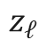
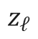
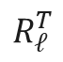
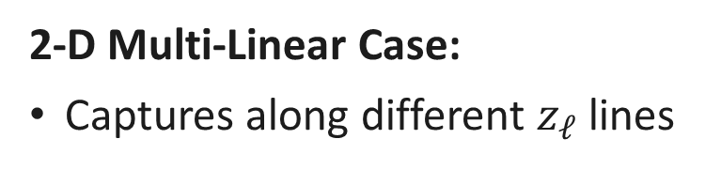

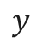
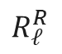
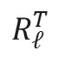
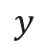

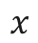
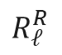
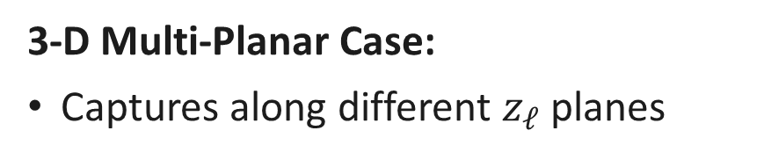
Multi-Planar Array Concept
2-D Multi-Linear Case:
Captures along different $z_{ℓ}$ lines
3-D Multi-Planar Case:
Captures along different $z_{ℓ}$ planes
$$y$$
$$y$$
Tx
Tx
Rx
Rx
$$x$$
$$R_{ℓ}^{R}$$
Target
$$R_{ℓ}^{R}$$
$$R_{ℓ}^{T}$$
$$R_{ℓ}^{T}$$
Target
$$z_{ℓ}$$
$$z$$
$$z$$
$$z_{ℓ}$$

Slide 10
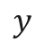
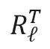
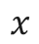
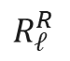
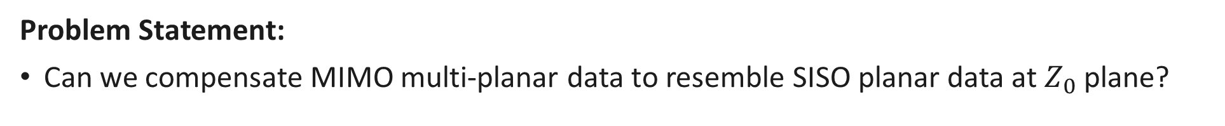
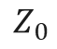

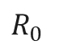
Multi-Planar Array Compensation
Problem Statement:
Can we compensate MIMO multi-planar data to resemble SISO planar data at $Z_{0}$ plane?
$$y$$
Tx
Rx
$$x$$
$$R_{ℓ}^{R}$$
$$R_{0}$$
$$R_{ℓ}^{T}$$
Target
$$Z_{0}$$
$$z$$

Slide 11
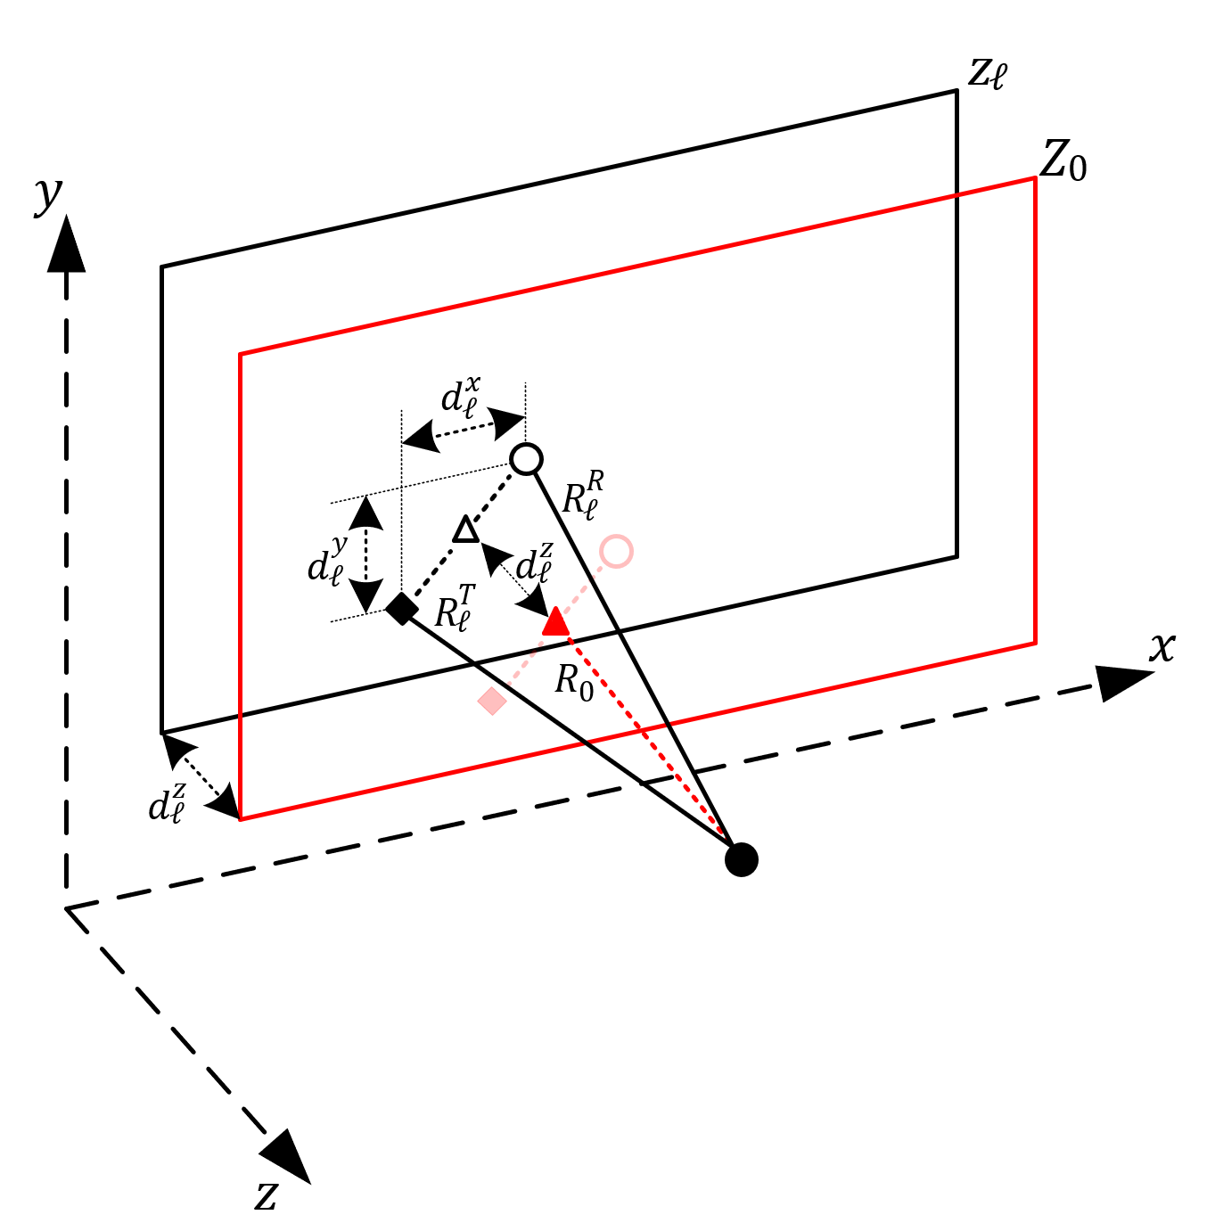
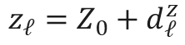
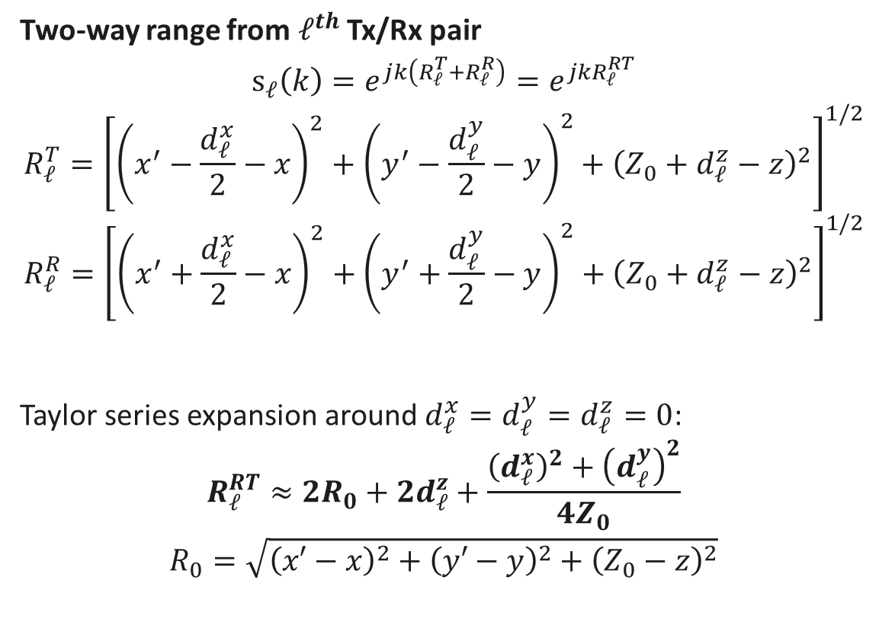
Signal Model
Two-way range from $ℓ^{th}$ Tx/Rx pair
$$s_{ℓ}\left(k\right)=e^{jk\left(R_{ℓ}^{T}+R_{ℓ}^{R}\right)}=e^{jkR_{ℓ}^{RT}}$$
$$R_{ℓ}^{T}={\left[{\left(x^{′}−\frac{d_{ℓ}^{x}}{2}−x\right)}^{2}+{\left(y^{′}−\frac{d_{ℓ}^{y}}{2}−y\right)}^{2}+{\left(Z_{0}+d_{ℓ}^{z}−z\right)}^{2}\right]}^{1/2}$$
$$R_{ℓ}^{R}={\left[{\left(x^{′}+\frac{d_{ℓ}^{x}}{2}−x\right)}^{2}+{\left(y^{′}+\frac{d_{ℓ}^{y}}{2}−y\right)}^{2}+{\left(Z_{0}+d_{ℓ}^{z}−z\right)}^{2}\right]}^{1/2}$$
Taylor series expansion around $d_{ℓ}^{x}=d_{ℓ}^{y}=d_{ℓ}^{z}=0$:
$$R_{ℓ}^{RT}≈2R_{0}+{2d}_{ℓ}^{z}+\frac{{\left(d_{ℓ}^{x}\right)}^{2}+{\left(d_{ℓ}^{y}\right)}^{2}}{4Z_{0}}$$
$$R_{0}=\sqrt{{\left(x′−x\right)}^{2}+{\left(y′−y\right)}^{2}+{\left(Z_{0}−z\right)}^{2}}$$
Tx
Rx
$$z_{ℓ}=Z_{0}+d_{ℓ}^{z}$$

Slide 12
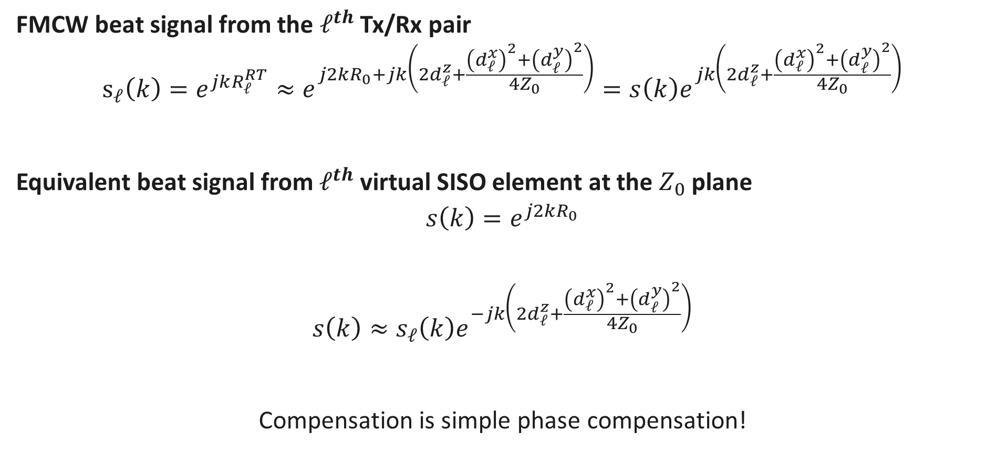
Signal Model (cont.)
FMCW beat signal from the $ℓ^{th}$ Tx/Rx pair
$$s_{ℓ}\left(k\right)=e^{jkR_{ℓ}^{RT}}≈e^{j2kR_{0}+jk\left(2d_{ℓ}^{z}+\frac{{\left(d_{ℓ}^{x}\right)}^{2}+{\left(d_{ℓ}^{y}\right)}^{2}}{4Z_{0}}\right)}=s\left(k\right)e^{jk\left(2d_{ℓ}^{z}+\frac{{\left(d_{ℓ}^{x}\right)}^{2}+{\left(d_{ℓ}^{y}\right)}^{2}}{4Z_{0}}\right)}$$
Equivalent beat signal from $ℓ^{th}$ virtual SISO element at the $Z_{0}$ plane
$$s\left(k\right)=e^{j2kR_{0}}$$
$$s\left(k\right)≈s_{ℓ}\left(k\right)e^{−jk\left(2d_{ℓ}^{z}+\frac{{\left(d_{ℓ}^{x}\right)}^{2}+{\left(d_{ℓ}^{y}\right)}^{2}}{4Z_{0}}\right)}$$
Compensation is simple phase compensation!

Slide 13
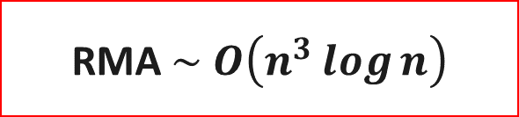

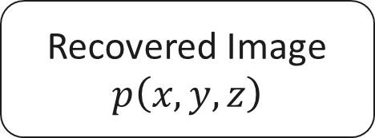
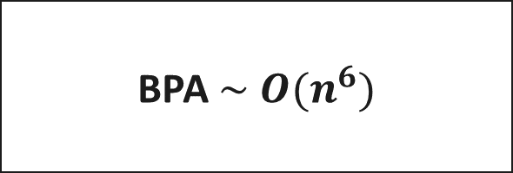



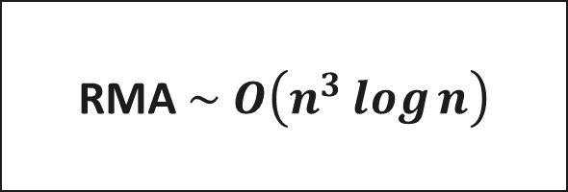
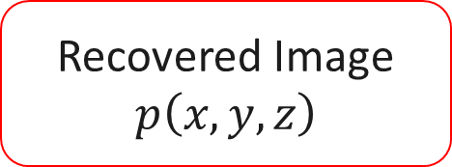
Algorithm Comparison
$$s_{ℓ}\left(k\right)$$
$$s_{ℓ}\left(k\right)$$
$$s_{ℓ}\left(k\right)$$
Phase Compensation
BPA $\sim O(n^{6})$
RMA $\sim O\left(n^{3}\log{n}\right)$
RMA $\sim O\left(n^{3}\log{n}\right)$
Recovered Image
$$p\left(x,y,z\right)$$
Recovered Image
$$p\left(x,y,z\right)$$
Recovered Image
$$p\left(x,y,z\right)$$

Slide 14
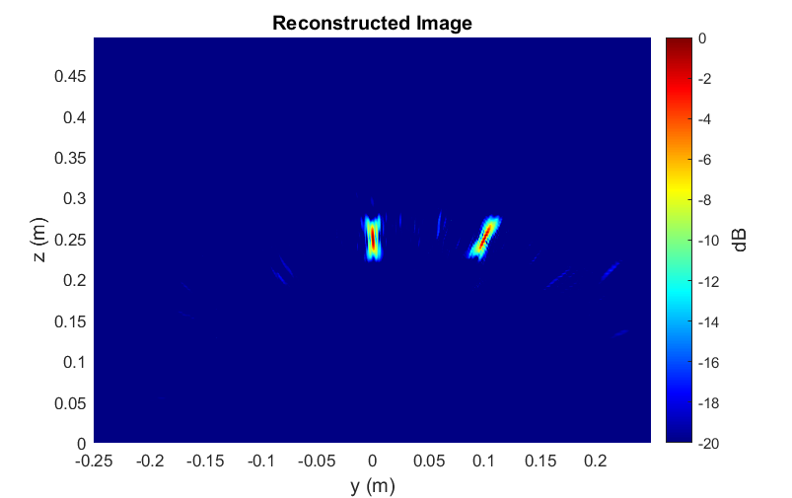
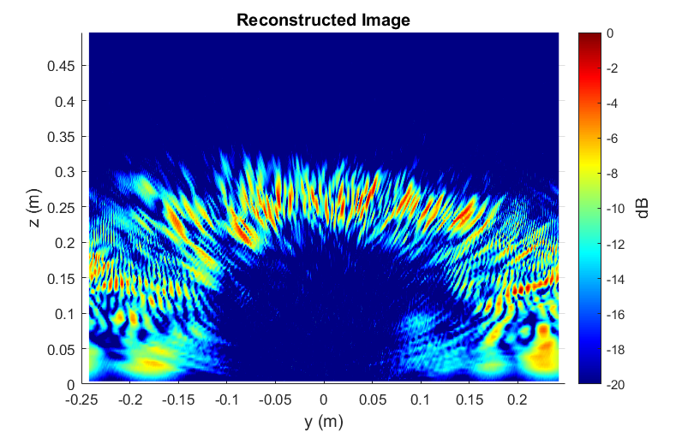
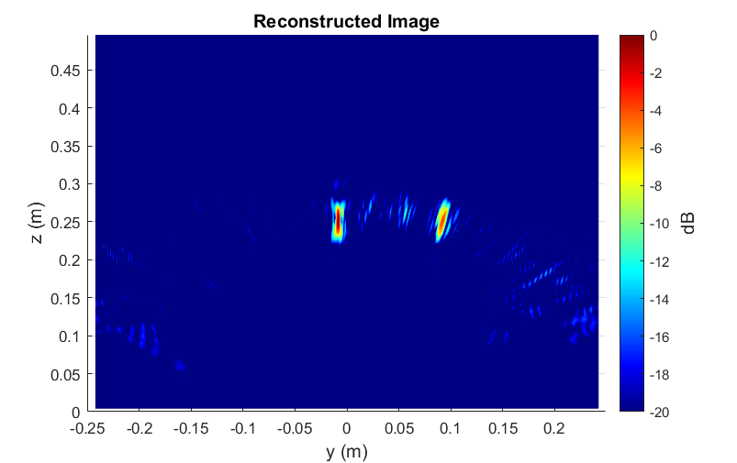
Simulation Results
Multi-Linear Array – Point Targets
Antenna perturbance: Gaussian
BPA – 5 mins
RMA – 30 ms
Ours – 30 ms

Slide 15
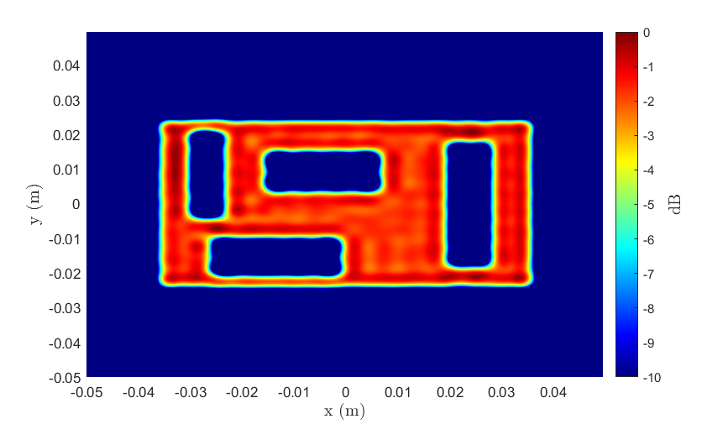
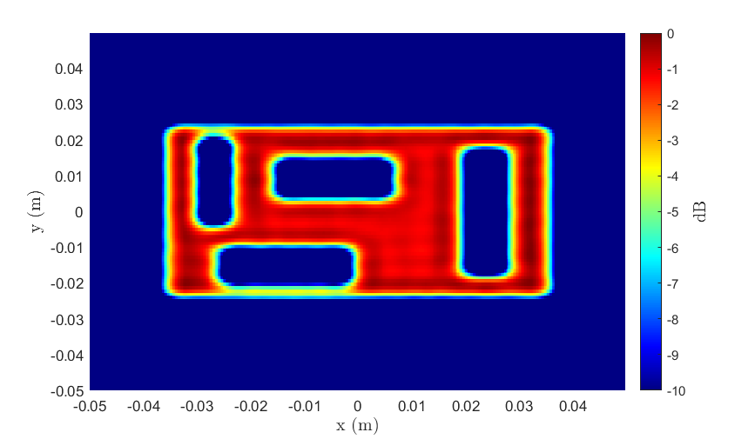
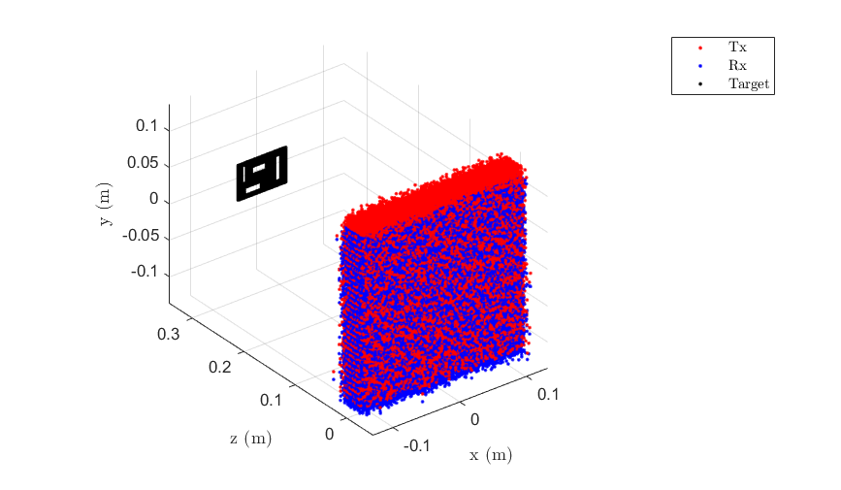
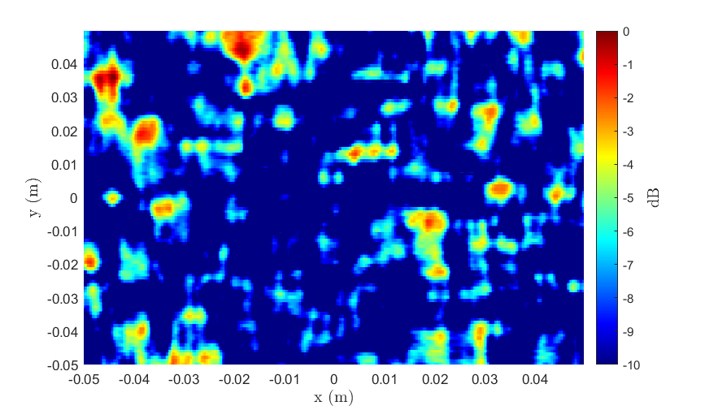
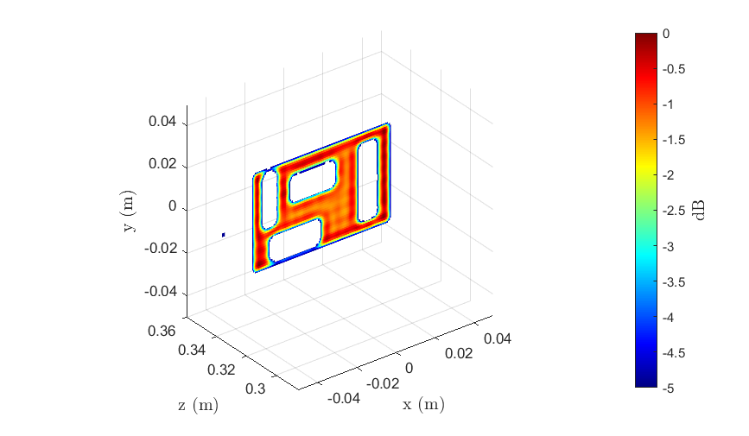
Simulation Results
Multi-Planar Array – Cutout
2-D BPA – 3 hrs
3-D BPA – 150 hrs
Ours – 1 s
RMA – 1 s
Ours – 14 s

Slide 16
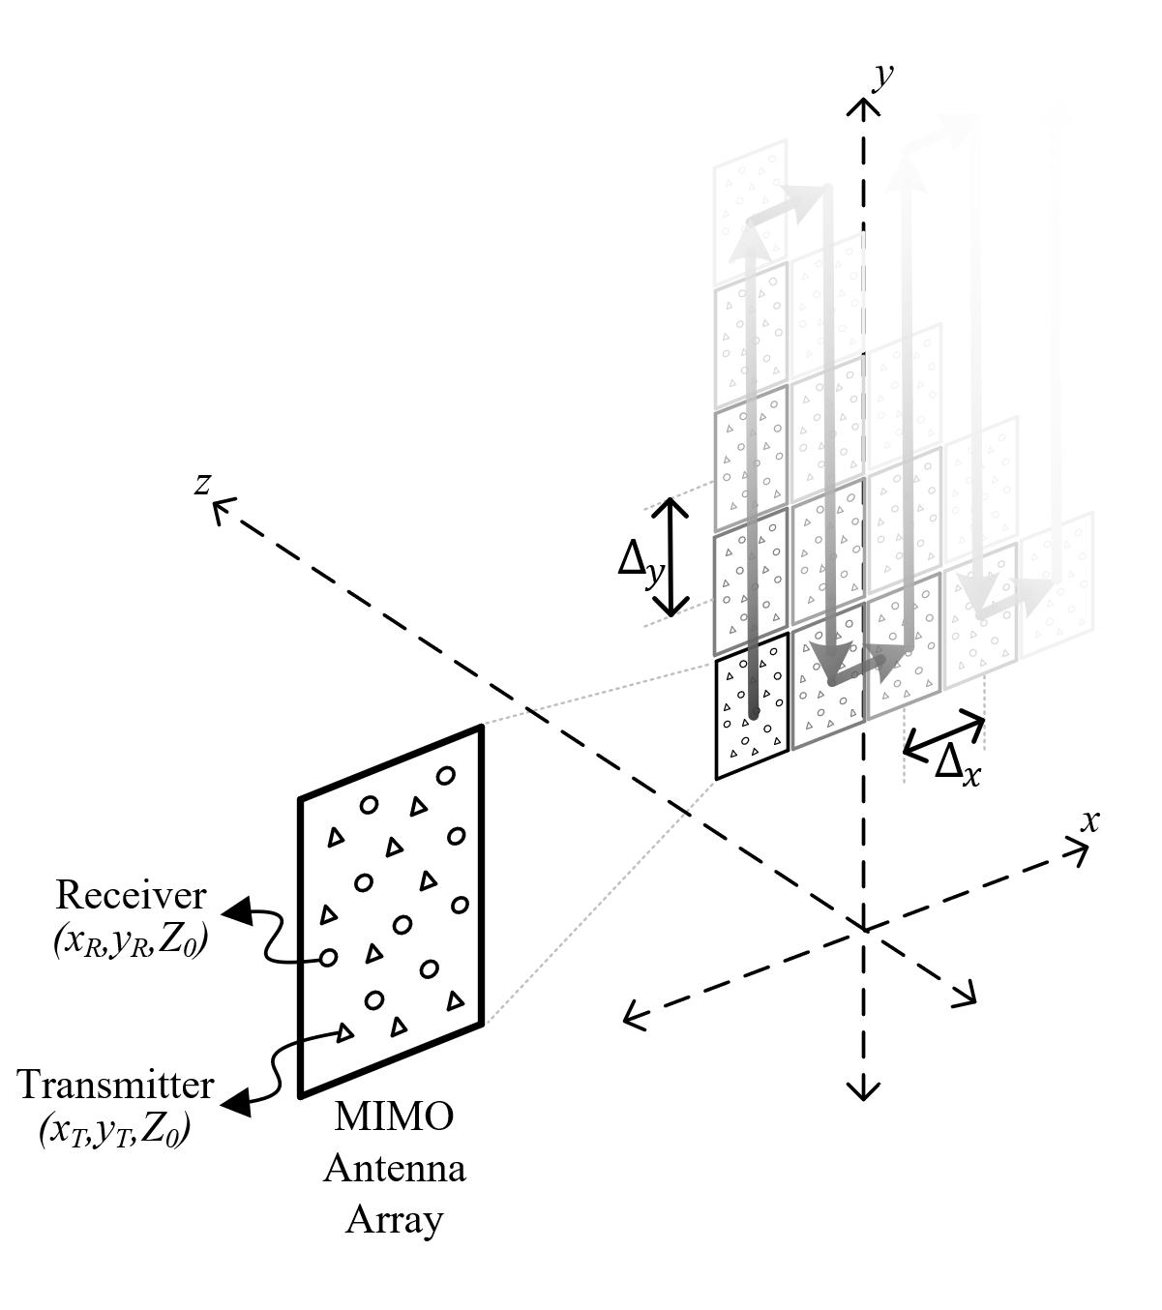

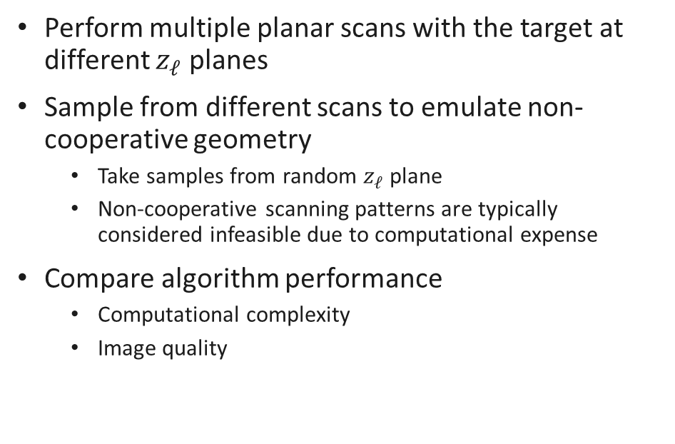
System Design
Multi-Planar Array – Emulate Non-cooperative Geometry
Perform multiple planar scans with the target at different $z_{ℓ}$ planes
Sample from different scans to emulate non-cooperative geometry
Take samples from random $z_{ℓ}$ plane
Non-cooperative scanning patterns are typically considered infeasible due to computational expense
Compare algorithm performance
Computational complexity
Image quality

Slide 17
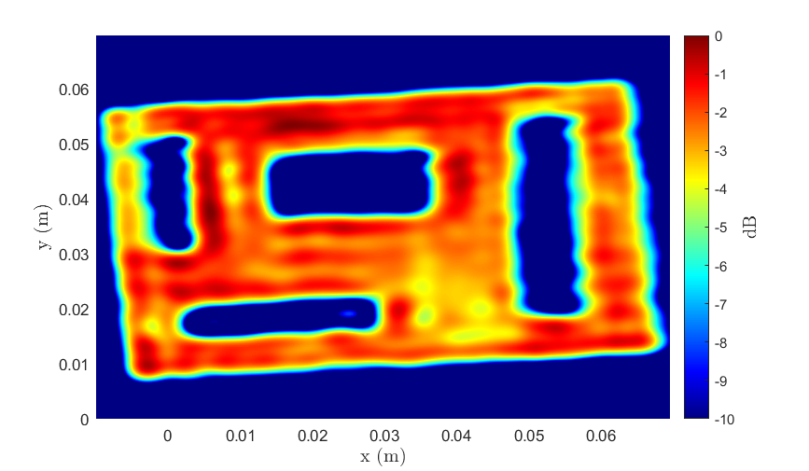
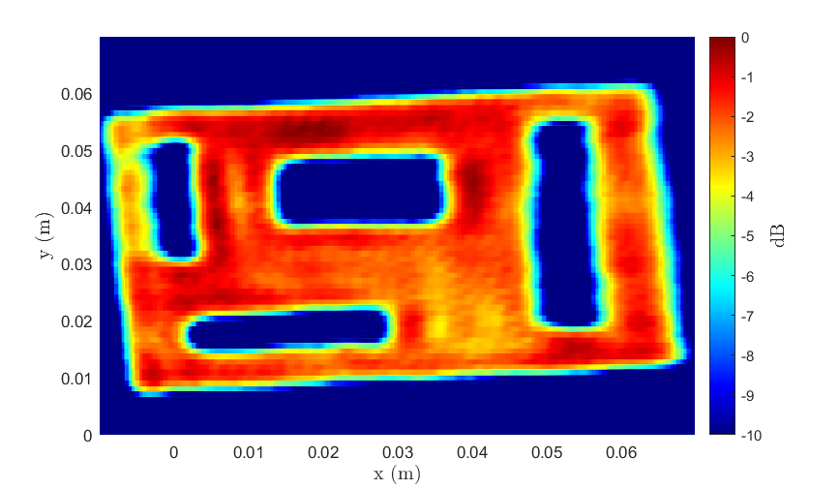
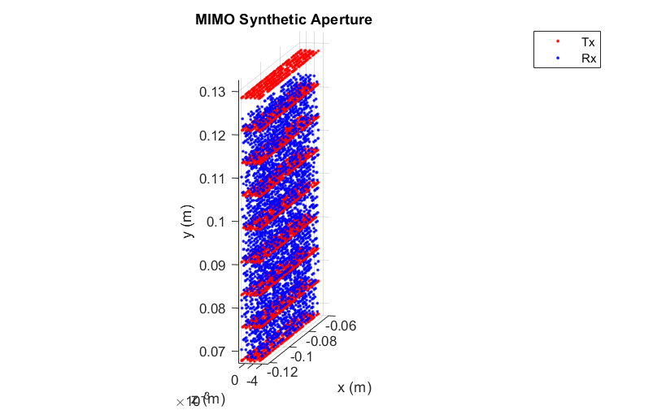
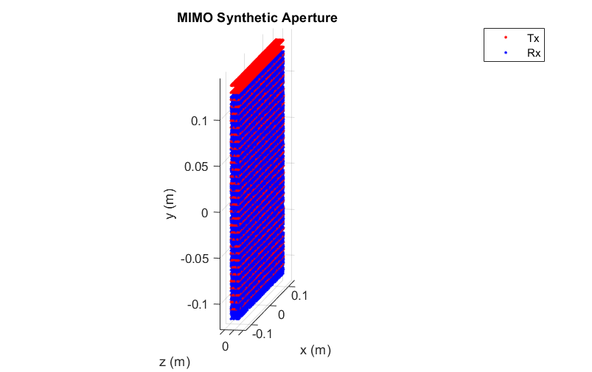
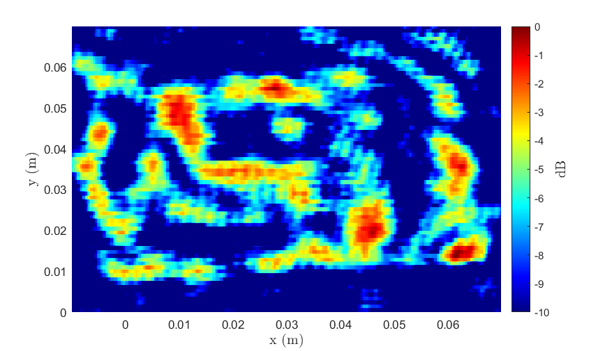
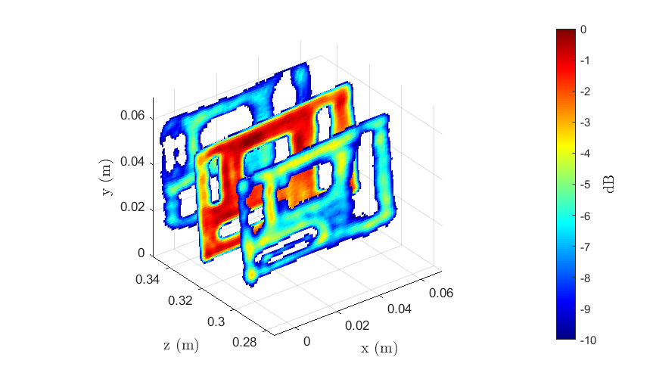
Real Results
Multi-Planar Array – Cutout
Antenna perturbance: Uniform Random
2-D BPA – 3 hrs
3-D BPA – 150 hrs
Ours – 1 s
RMA – 1 s
Ours – 14 s

Slide 18
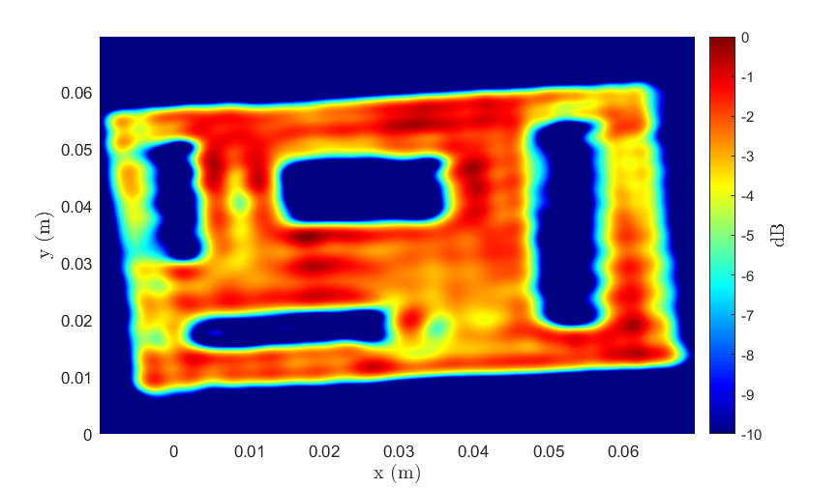
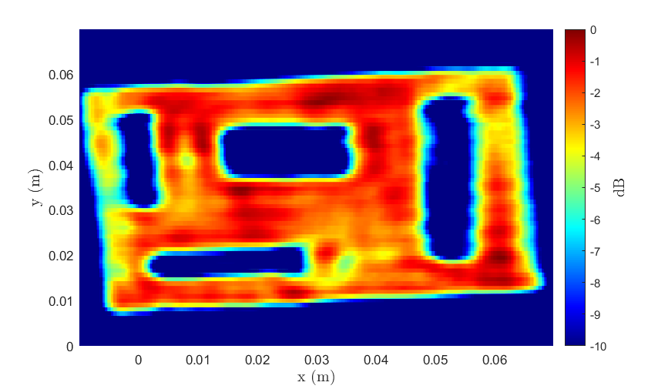
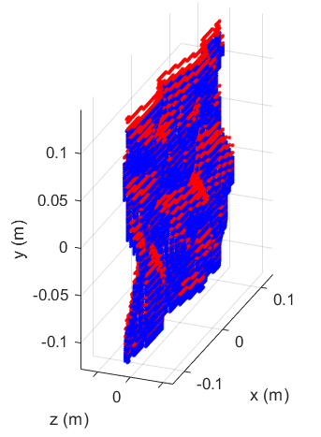


Real Results
Multi-Planar Array – Cutout
Antenna perturbance: Emulated Freehand
2-D BPA – 3 hrs
3-D BPA – 150 hrs
Ours – 1 s
RMA – 1 s
Ours – 14 s

Slide 19



Conclusions and Summary
Enables non-cooperative image computation on mobile devices, cell phones, IOT applications
Same computational complexity as RMA with comparable image quality to BPA
 | BPA | RMA | Ours
Computational Complexity | $$O\left(n^{6}\right)$$ | $$O\left(n^{3}\log{n}\right)$$ | $$O\left(n^{3}\log{n}\right)$$
Image Quality | Acceptable | Unacceptable | Acceptable
Sample Image

Slide 20
Application II Vital Sign Detection
Bhaskar Upadhyay

Slide 21








Motivation – Why non-contact vital signs detection?
Commercial vital sign (heart rate and respiration) detection systems traditionally wearable
Not feasible in all scenarios
Track vital signs of bed ridden patients to detect problems in breathing and sudden changes in heart rate
Even more important in case of burn victims and newborn babies
Applicable to numerous scenarios:
Track vital signs of drivers
Locating survivors in search and rescue missions

Slide 22



Vital Signs Detection Using FMCW Radars
FMCW Signal
Transmit a FMCW chirp signal$S_{Tx}\left(t\right)=\exp\left\{j \left\{2πf_{o}t+πμt^{2}+φ\left(t\right)\right\}\right\}$
Signal reflected from subject and a delayed version is received by the receiver
$$S_{Rx}\left(t\right)=B.S_{Tx}\left(t−τ\right)=B\exp\left\{j \left\{2πf_{o}(t−τ)+πμ{(t−τ)}^{2}+φ\left(t−τ\right)\right\}\right\}$$
The two are ‘mixed’, giving an IF signal, which contains information about the range and location of the subject
The phase changes caused by breathing and heart rates evaluated to extract vital signs
After ADC sampling, the IF signal at $i^{th}$ receive element is
Angle
$$y_{i}\left(m,p\right)= \sum_{n=1}^{K}{α_{n}exp\left\{j2π\left[\left(\frac{2μR_{n}}{c}\right)pT_{s}+\frac{2f_{o}R_{n}}{c}+\frac{\left(i−1\right)f_{o}dsin\left(θ_{n}\right)}{c}+\frac{{2r}_{b,n}f_{o}}{c}\sin\left(2πf_{b,n}\left(mT_{int}+pT_{s}\right)\right)+\frac{{2r}_{h,n}f_{o}}{c}\sin\left(2πf_{h,n}\left(mT_{int}+pT_{s}\right)\right) \right]\right\}}$$
Range
Breathing
Heartbeat

Slide 23


























Vital Signs Detection Using mmWave Radars
$$TDM Transmission Scheme$$
$${TX}_{1}$$
$$f$$
$${TX}_{2}$$
$$Frame 1$$
$$Frame 2$$
$$Frame M$$
$$t$$
$$T_{FRI}$$
$$Antenna Array Structure$$
Evaluation scheme
Single chirp samples (fast time) to resolve subject in range
Multi channel transmit and receive to resolve subject in angle (virtual channels)
Evaluate echo signal from subject across time (slow) to resolve vital signs
$${TX}_{1}$$
$${TX}_{2}$$
$${RX}_{1}$$
$${RX}_{2}$$
$${RX}_{3}$$
$${RX}_{4}$$
$$4d$$
$$d$$
$$d$$
$$d$$
$$x$$
$$Virtual Array$$
$$d$$
$$d$$
$$d$$
$$d$$
$$d$$
$$d$$
$$d$$
$$x$$

Slide 24

Problems
Sub mm scale vibrations
Low SNR of heart signal
Harmonics
Intermodulation products
Motion artifacts
Single channel systems and algorithms not robust
Harmonics
Respiration
Intermodulation Products
Weak Heart Signal
80
*
Heart Rate (bpm)
*
*
*
*
70
*
*
*
Spurs
*
*
*
*
60
Time (s)

Slide 25






Proposed Solution 1 – MIMO Rx Beamforming Based
Proposed Solution 2 – RF Lens Based
Lens
Radar
Radar

Slide 26









Proposed Solution 1 – MIMO Rx Beamforming Based
Proposed Solution 2 – RF Lens Based
People Counting
Search and Rescue
Driver fatigue
Sleep Monitoring

Slide 27

System Parameters
Parameter (FMCW) | Value
Number of Samples (fast time) | 128
Number of Frames (slow time) | 512
Frequency | 77 GHz
Bandwidth (BW) | 4 GHz
PRF (Slow Time) | 20 Hz
NRx antennas | 4
NTx antennas | 2
Measurement Time $\sim$ 25 s

Slide 28





Proposed Solution 1 – MIMO Rx Beamforming Based – Results
a. Vital Signs Spectrum
b. Vital Signs Pseudo Spectrum
Mean Absolute Error (MAE) – 1.69 bpm
Accuracy – 91.85 %
c. Heart Rate Tracking Across Time
e. Bland-Altmann Plot

Slide 29







RF Lens Based Solution – Lens Cage Experiments
1
2
SNR improvements due to the lens
Focusing property and lens geometry helps resolve echoes from different points on the body
Channel selection based on spectral PAPR
“Need based” Harmonic correction implemented
$$d_{fb}$$
DCA1000EVM
AWR1843BOOST
3
4
Lens placed at a distance $d_{fb}$ in front of sensor (back focal length of the lens)
3D printed lens cage designed for stability and movement
Subjects positional analysis done to identify capability of heart rate detection
3D Printed Lens Cage System
LAT-115 Lens

Slide 30




Verifying Region of Focus Corner Reflector
Total x-axis motion = 50 cm
Total y-axis motion = 40 cm
Approximate 6 dB deviation from maximum at ~ 6 cm
If the object moves from one point to the next (from $a_{o}$ to $c_{o}$) The position of image also moves (from $a_{2}$ to $c_{2}$)
From $a_{2}=−\frac{z_{1}}{z_{o}}a_{o}$ and $b_{2}=−\frac{z_{1}}{z_{o}}b_{o}$
What the Rx antenna sees at each of these points is a fraction of the intensity based on the location of the Point Spread Function
Different RX’s dominated by signal coming off different points in the torso

Slide 31








SNR gain and channel variation with lens
With Lens
Without Lens
Rx 1
Rx 2
Rx 1
Rx 2
Rx 3
Rx 4
Rx 3
Rx 4
Ground value: ~86 bpm
With lens – High deviations in spectrum across receivers

Slide 32



Channel selection – Spectral Peak to Average Power Ratio (PAPR method)
Red line denotes the ground value
$PAPR_{ch2}>PAPR_{ch1}$
Select channel 2
Consider the estimate of selected channel as heart rate estimate
Within this region:
Compute the Peak to Average Power Ratio

Slide 33









Heart Rate Visibility Different Orientations of subject
Heart rate visible for all positions
Peak strength varies
Lens based approach can be applied for applications with positional changes
Sleep monitoring
Heart rate peak

Slide 34




Heart Rate Tracking Still subject facing sensor
Heart Rate Tracking Across Time
Limited experiments, promising results
Subject still
Accuracy $≈$ 90 % (at optimal points)

Slide 35

Heart Rate Tracking Still subject facing sensor
Heart Rate Tracking Across Time
Limited experiments, promising results
Subject still
Accuracy $≈$ 90 % (at optimal points)

Slide 36


Summary of Pilot Studies
Combining Technique | Max Peak Isolated
Non Coherent | $$\sim 20\%^{∗}$$
Rx – Beamforming + PAPR Condition on angle bin | $$\sim 60\%$$
Current Problems
Motion corruption increases progressively from laying down to sitting to standing positions.
Artifacts of small scale body motion appear at vital sign frequencies.
Current Research
Time frequency analysis to resolve and remove effect of motion.
Utilize algorithm for real time application with motion.
Goal
Make algorithm robust even against motion.
Combining Technique | Max Peak Isolated
Rx Beamforming Peak Tracking and Counting | $$\sim 91\%$$
Mean Absolute Errors | 1.69 bpm
Use of lens improves vital signs detection
Doppler Peak to Average Power Ratio (PAPR) method utilized for channel selection.
With harmonic check algorithm added, accuracy increases further. (> 90%)
Both solutions are worth exploring – use depends on application case

Slide 37

Dissemination Activities
Industry interactions
Monthly reviews with Texas Instruments
Project discussions with liaisons at TI
SRC Annual reports and publications
SRC e-seminars
TxACE talks
IEEE Special Issue on Automotive Radars
Conference presentations
Techcon submissions
Nominated for the best paper award in IEEE SP Magazine

Slide 38
Publications
M. Yanik, D. Wang and M. Torlak, “3-D MIMO-SAR Imaging Using Multi-Chip Cascaded Millimeter-Wave Sensors,” Proc. IEEE Globalsip Conf., Nov. 11-14, 2019, Ottawa, Canada.
M. Yanik, D. Wang and M. Torlak, "Development and Demonstration of MIMO-SAR mmWave Imaging Testbeds," IEEE Access, vol. 8, pp. 126019-126038, July 8, 2020.
J. W. Smith, M. Yanik, and M. Torlak, “Near-Field MIMO-ISAR Millimeter-Wave Imaging, Proc. IEEE Radar Conf., Sept. 21-25, 2020, Florence, Italy.
A. B. Baral and M. Torlak, “Joint Doppler Frequency and Direction of Arrival Estimation for TDM MIMO Automotive Radars,” IEEE Journal of Sel. Topics in Signal Proc., Sept. 2020, submitted.
Guest Editor, IEEE JSTSP Special Issue on Recent Advances in Automotive Radar Signal Processing

